Slide 1
Mood boards (ideas & current vision)
Ionut Ciobanu
Group 7

Slide 2
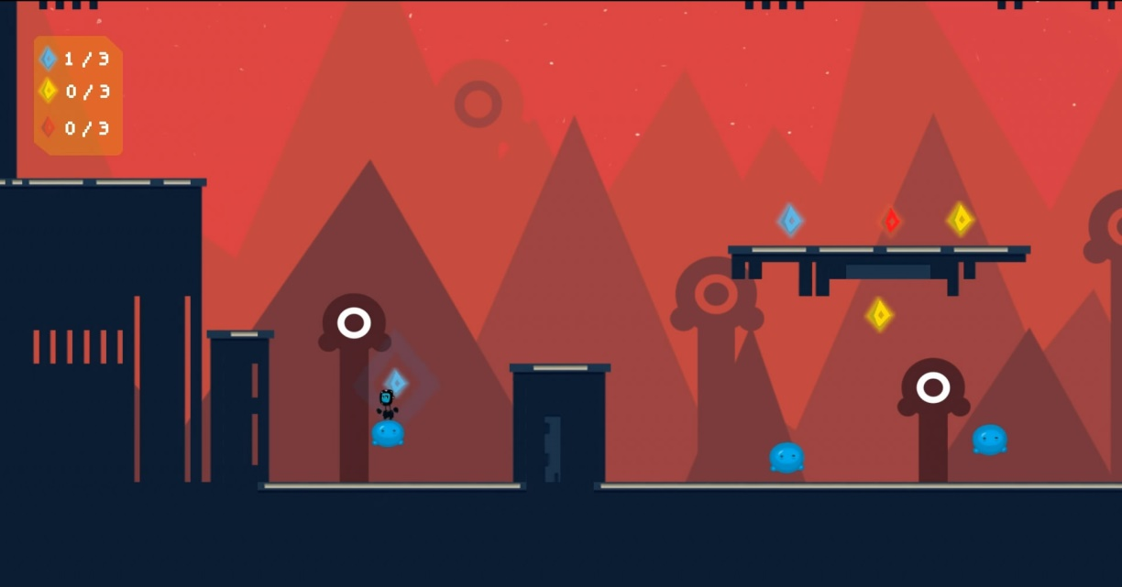
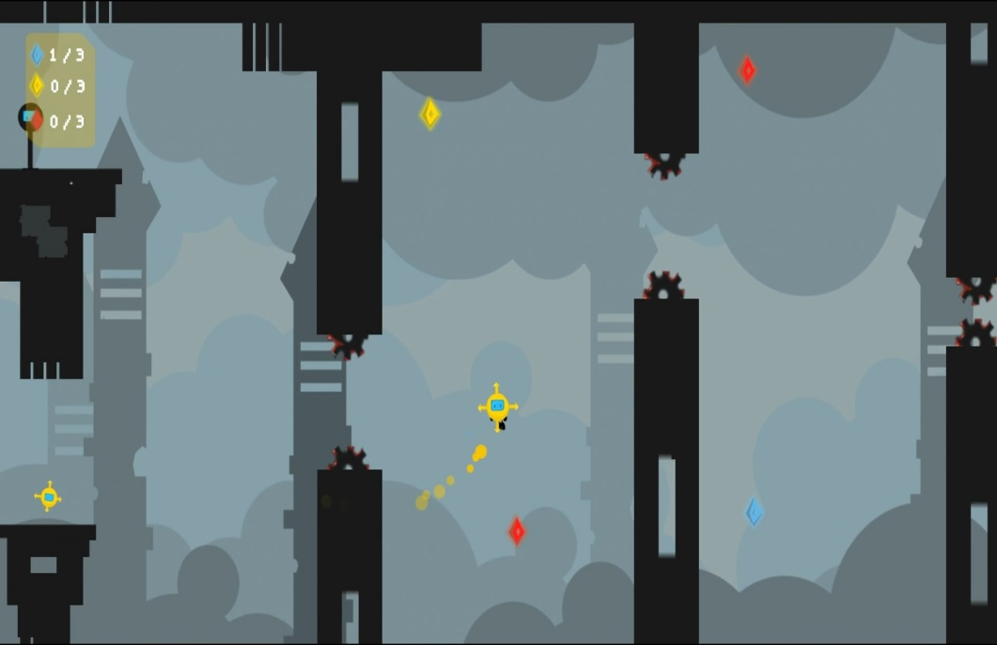
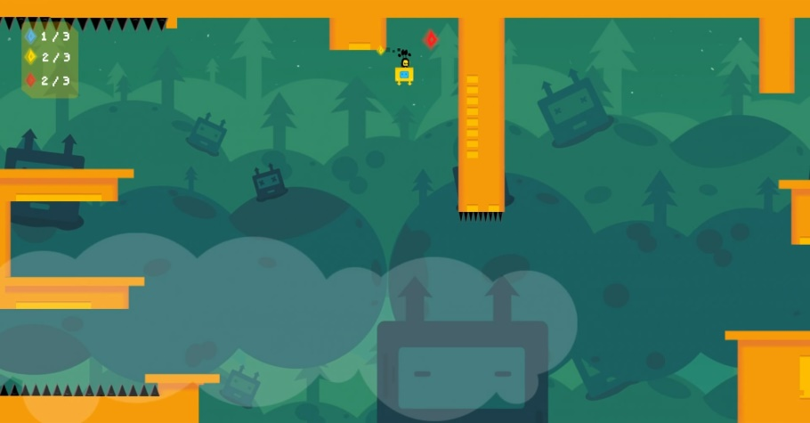
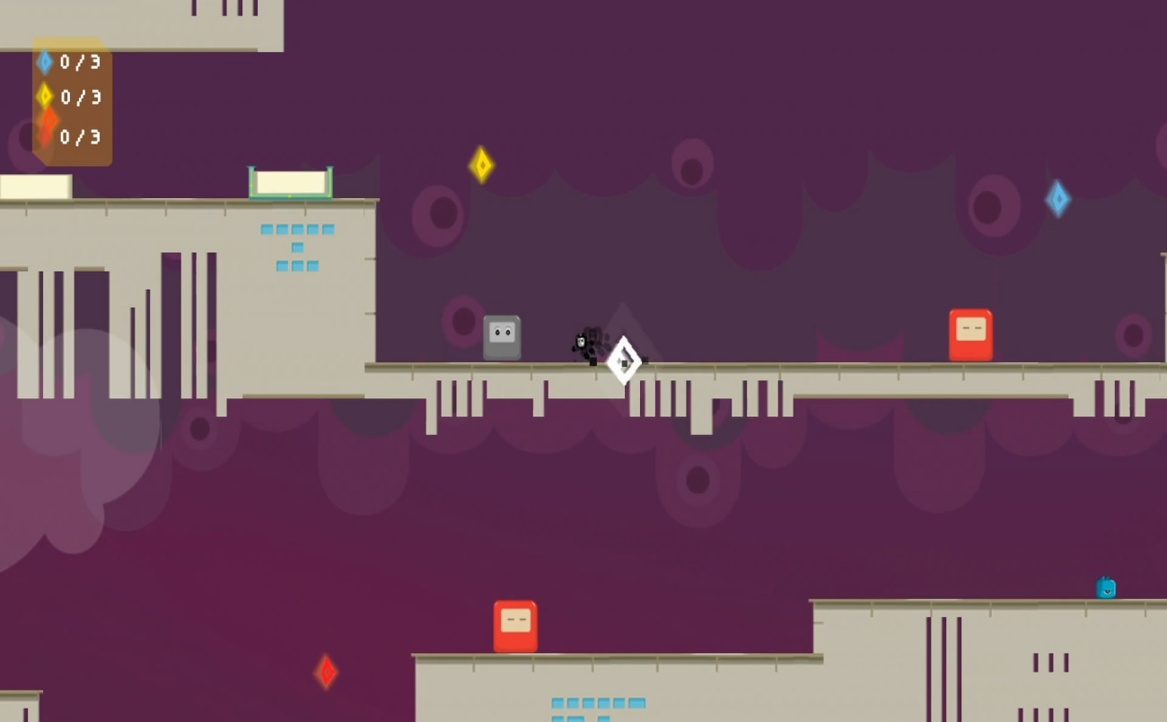
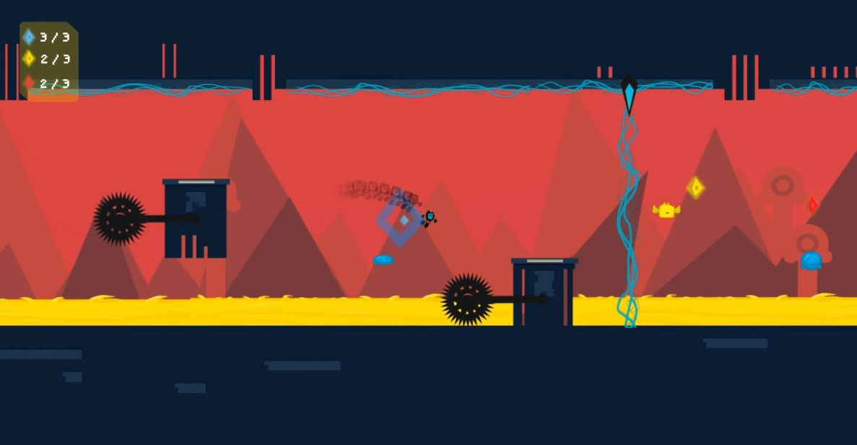

Slide 3
‘Fisk’
Clean, ‘vectorial’ assets
Simple art style
Easy to realise yet effective assets
Good contrast between vivid and dark colours
Dark assets -> vivid background
Vivid assets -> dark background
No over-the-top animations that would otherwise be unnecessary
Simple animations that convey the necessary information to the player just fine

Slide 4
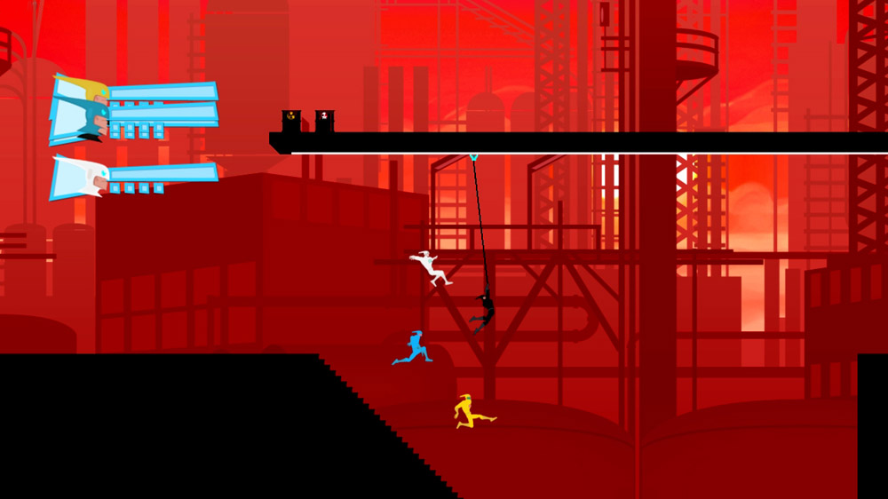
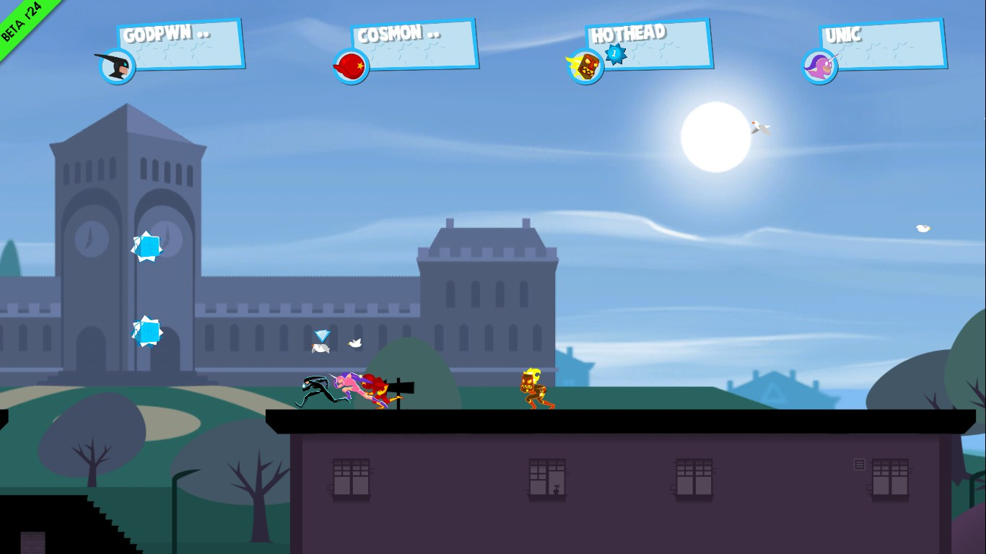

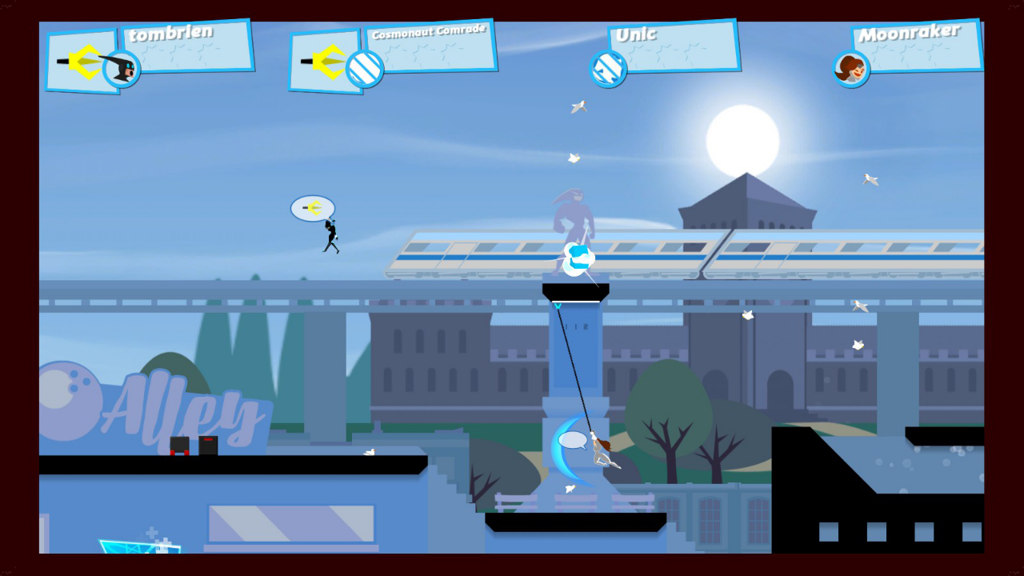

Slide 5
‘Speedrunners’ – similar to ‘Fisk’
‘Vectorial’ platforms
Parallax effect for backgrounds
Backgrounds are somewhat richer
Contrasting platforms and backgrounds so the players can easily tell them apart
Character animations are fluid and detailed: The character poses convey information to the players and are of extreme importance in a competitive game. A skilled player can tell what his opponent is about to do by reading the animations.

